Slide 1
TOPIC:- AIR CONDITIONER
Pacific school of engineering,
Surat.
Submitted by:-
MANGUKIYA KRUPA [131120131028]
Maniya Saguna [131120131029]
Mangroliya Kishan
[131120131027]
Guided by:-
MR. VATSAL Patel
Asst. prof. Mechanical Engg. Dept.
BRANCH:- COMPUTER SCIENCE AND ENGINEERING

Slide 2
AIR-CONDITIONING
AIR-CONDITIONING IS DEFINED AS THE CONTROL OF TEMPERATURE, HUMIDITY, AIR MOVEMENT AND THE PURITY OF AIR IN AN ENCLOSED SPACE.
WHEREAS, REFRIGERATION ONLY INVOLVES THE CONTROL OF TEMPERATURE IN SPACE.
AIR-CONDITIONING IS NEEDED FOR HUMAN COMFORT AND AS WELL FOR INDUSTRIAL APPLICATIONS.

Slide 3
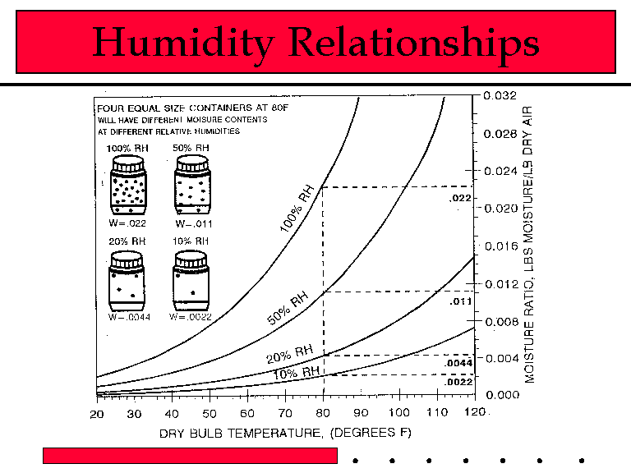
Humidity in air
Relative Humidity:-
A measure of of much water is in the air relative to the maximum amount air can hol at that tmperature.

Slide 4
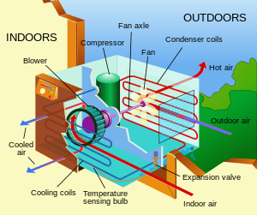
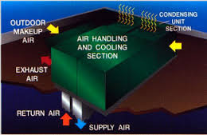
Air conditioning

Slide 5
Air conditioners
An air conditioner
moves heat from cold room air to hot outside air
moves heat against its natural flow
must convert ordered energy into disordered energy
so as not to decrease the world’s total entropy!
uses a “working fluid” (chlorofluorocarbons –freon-, hydrofluorocarbons)to transfer heat
This fluid absorbs heat from cool room air
This fluid releases heat to warm outside air

Slide 6
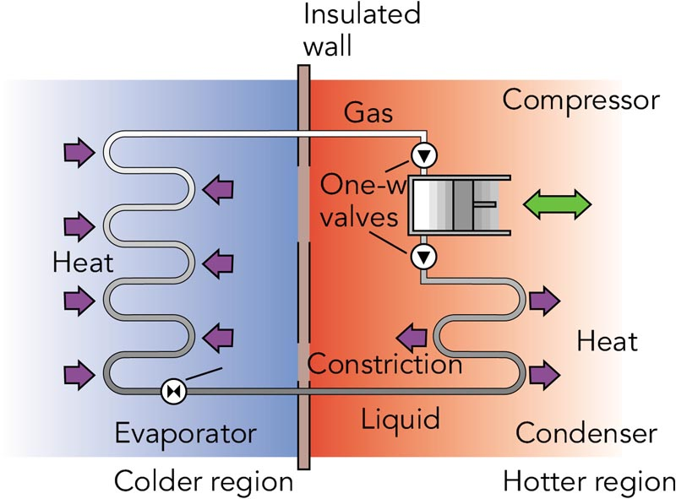
Air conditioners
Evaporator:-
is located in room air
transfers heat from
room air to working fluid
Condenser:-
is located in outside air
transfers heat from working
fluid to outside air
Compressor:-
is located in outside air
does work on working fluid
and produces entropy

Slide 7
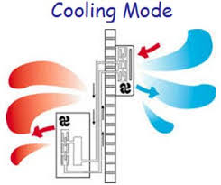
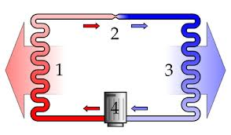

Slide 8
WINDOW AIR CONDITIOER
THE CONDENSER AND EVAPORATOR ARE FITTED AT TWO ENDS AND THE HERMETICALLY SEALED COMPRESSOR IS IN THE MIDDLE.
THERE IS AN INSULATED CABINET AROUND THE COOLING COIL WITH TWO COMPARTMENTS.
A BLOWER IS FITTED IN THIS CABINET BEHIND EVAPORATOR COIL WHICH PUMPS AIR INTO UPPER COMPARTMENT.

Slide 9
THE BLOWER PULLS ROOM AIR THROUGH COOLING COIL AND THROUGH THE FILTER FITTED ON THE FACE OF THE COIL.
THIS AIR IS THEN DISCHARGED BACK TO THE ROOM THROUGH THE UPPER COMPARTMENT.
IN SOME MODELS THE DISCHARGE IS DONE FROM THE SIDE OF THE COIL.

Slide 10
THE CONDENSER COOLING IS DONE BY A FAN, WHICH PULLS AIR FROM SIDES AND THROWS OVER THE CONDENSER COIL.
THE FAN AND THE BLOWER ARE BOTH RUN BY THE SAME MOTOR.
THE MOTOR HAS TWO SPEEDS, CONTROLLED BY A KNOB ON THE CONTROL PANEL.
THE CONTROL PANEL HAS THREE KNOBS.

Slide 11
ONE CONTROLS SPEED OF THE BLOWER MOTOR TO GIVE HIGH COOL OR LOW COOL.
THE SECOND KNOB IS OF A THERMOSTAT, THE BULB OF WHICH IS PLACED AT THE FILTER TO SENSE TEMPERATURE OF ROOM AIR BEING SUCKED IN BY THE BLOWER.
THIS ALLOWS THE USER TO SET ROOM TEMPERATURE.
THE THIRD KNOB OPERATES A FLAP IN THE INSULATED CABINET TO ALLOW VENTILATION AIR SUPPLY.

Slide 12
LIMITATIONS OF WINDOW AIR CONDITIONER:-
IF HAS NO CONTROL OVER HUMIDITY THROUGH IT CARRIES OUT DEHUMIDIFICATION.
MOST OF THE WINDOW AIR CONDITIONERS DO NOT PROVIDE HEATING FOR WINTER.
NO PROVISION FOR HUMIDIFICATION IS POSSIBLE IN WINDOW AIR CONDITIONER.
OUTSIDE TEMPERATURE ABOVE 40`C WOULD CAUSE DERATING OF THE CONDITIONER.

Slide 13
CERTAIN PRECAUTION SHOULD BE TAKEN WHILE INSTALLING A WINDOW AIR CONDITIONER:-
IF SHOULD BE INSTALLED WITH A TILT (3` TO 5`) TOWARDS OUTSIDE.
THIS ENSURES THAT CONDENSATE AT THE COOLING COIL IS DRAINED OFF TO OUTSIDE OF THE ROOM.
IT IS ENSURED THAT CONDENSER IS NOT EXPOSED TO DIRECT SOLAR HEAT TO PREVENT UNDUE RISE IN CONDENSER PRESSURE.

Slide 14
THERE SHOULD BE NO OBSTRUCTION ON THE SIDE OF THE PACKAGE AS IT WOULD REDUCE AIRFLOW TO THE CONDENER.
THE GAPS BETWEEN THE WALL OPENING AND THE PACKAGE ARE BLOCKED BY INSULATION.
THE WINDOW AIR CONDITIONER COMES IN CAPACITIES OF 1, 1.5, 2 AND 3 TR.

Slide 15
SPLIT AIR CONDITIONER
AS THE NAME SUGGESTS, THIS SYSTEM IS DESIGNED BY SPLITTIN THE WINDOW AIR CONDITIONER IN TWO PARTS ALONG DOTTED LINE AS SHOWN IN FIG.10.114.1.
SO IT HAS A FAN COIL UNIT FITTED INSIDE THE ROOM AND CONDENSING UNIT INSTALLED OUTSIDE.
THE TWO UNITS ARE CONNECTED BY SUCTION LINE AND LIQUID LINE.
IN SOME CASES CAPILLARY IS INSIDE CONDENSING UNIT AND LOW-PRESSURE LIQUID IS SUPPLIED THROUGH AN INSULATED LINE TO THE FAN COIL UNIT.

Slide 16
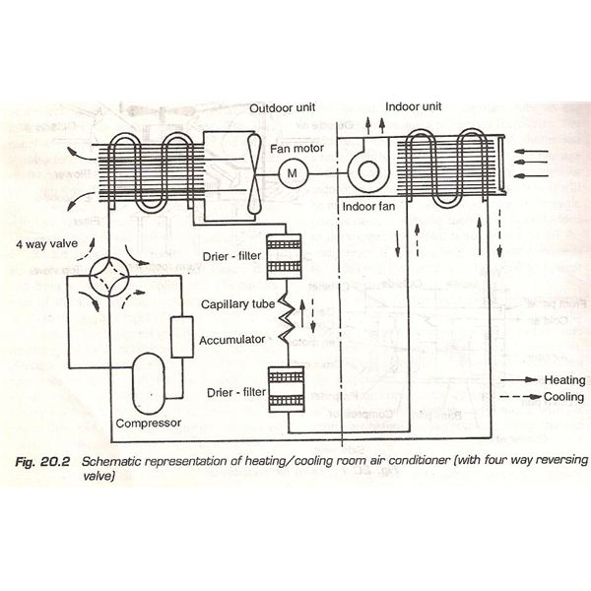
SPLIT-SYSTEM AIR CONDITIONING:-

Slide 17
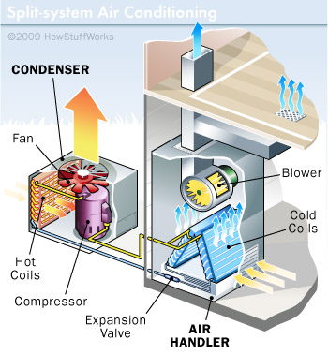
SPLIT-SYSTEM AIR CONDITIONING:-

Slide 18
THE NOISE GENERATION IN A WINDOW AIR CONDITIONER IS MAINLY DUE TO THE COMPRESSOR UNIT.
SO THE SPLIT AIR CONDITIONER ENSURES LOW NOISE LEVEL IN THE ROOM.
IT PREVENTS BLOCKAGE OF THE WINDOW, AS FAN COIL UNIT CAN BE INSTALLED ON THE WALL OF THE ROOM.
THE FAN COIL UNIT HAS GREATER AIR THROW THAN WINDOW AIR CONDITIONER.
IT IS SUITABLE FOR A ROOM WHICH HAS NO OUTSIDE WALL, WHICH IS NECESSARY FOR WINDOW AIR CONDITIONER.

Slide 19
HOWEVER SPLIT UNIT CONSUMES MORE ENERGY DUE TO TWO REASONS:-
THERE ARE TWO MOTORS ONE IN CONDENSING UNIT AND ANOTHER IN FAN COIL UNIT.
COMPRESSOR POWER REQUIREMENT INCREASES DUE TO LONG REFRIGERANT LINES.
A SPLIT AIR CONDITIONER HAS NO VENTILATION PROVISION.

Slide 20
SPLIT-SYATEM AIR CONDITIONERS COME IN TWO FORMS:-
CENTRAL SPLIT SYSTEM
MINI SPLIT SYSTEM
IN BOTH TYPES, THE INSIDE ENVIROMENT (EVAPORATIVE) HEAT EXCHANGER AND FAN IS SEPARATED DY SOME DISTANCE FROM THE OUTSIDE-ENVIRONMENT (CONDENSING UNIT) HEAT EXCHANGER AND FAN.

Slide 21
IN CENTRAL AIR CONDITIONING, THE INSIDE HEAT-EXCHANGER IS TYPICALLY PLACED INSIDE THE CENTRAL FURNACE/AC UNIT OF FORCED AIR HEATING SYSTEM WHICH IS THEN USED IN THE SUMMER TO DISTRIBUTE CHILLED AIR THROUGHOUT A RESIDENCE OR COMMERCIAL BUILDING.
A MINI-SPLIT SYSTEM TYPICALLY SUPPLIED CHILLED AIR TO ONLY A SINGLE SPACE, AND THUS WAS SOMETIMES REFERRED TO AS SPLIT-SYASTEM SINGLE-ZONE AIR CONDITIONING.

