Slide 1
G.K.BHARAD INST. OF ENGG.
DIVISION: D
SUBJECT: CALCULUS [2110014]
UNIT-5: PARTIAL DERIVATIVES
CREATED BY: -PAREKH HARDIK
-LODALIYA NAYAN
-GOTI GAURAV
- KABARIYA SANKET

Slide 2
CONTENTES
PARTIAL DERIVATIVES
TANGENT PLANE,NORMAL LINE.
EULER’S THEOREM FOR HOMOGENEOUS FUNCTION.
TOTAL DERIVATIVE AND CHAIN RULE.
MAXIMUM AND MINIMUM VALUES BY SECOND DERIVATIVE TEST.
LAGRANGES MULTIPLIERS.
TAYLOR’S FORMULA FOR TWO VARIABLES.

Slide 3
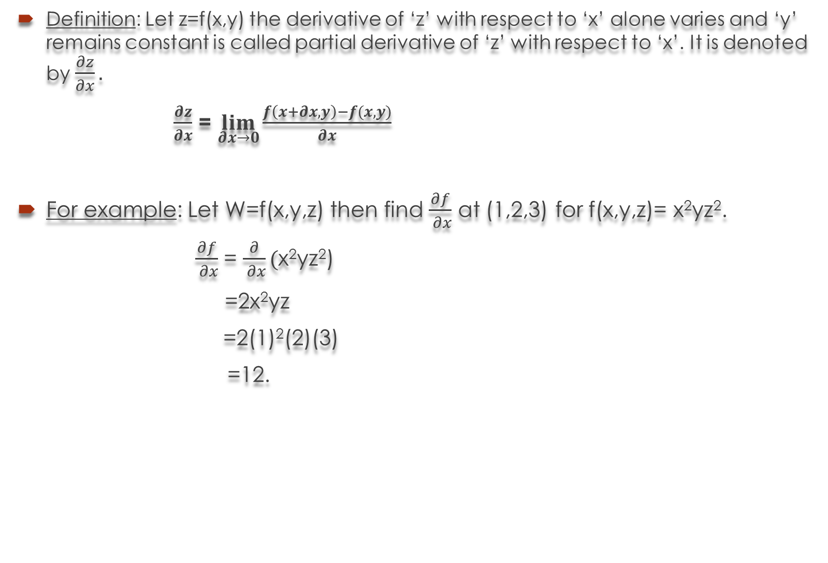
Definition: Let z=f(x,y) the derivative of ‘z’ with respect to ‘x’ alone varies and ‘y’ remains constant is called partial derivative of ‘z’ with respect to ‘x’.It is denoted by $\frac{∂z}{∂x}.$
$\frac{∂z}{∂x}$ = $\lim_{∂x→0}{\frac{f\left(x+∂x,y\right)−f(x,y)}{∂x}}$
For example: Let W=f(x,y,z) then find $\frac{∂f}{ ∂x}$ at (1,2,3) for f(x,y,z)= x²yz².
$\frac{∂f}{ ∂x}$ = $\frac{∂}{ ∂x}($x²yz²)
=2x²yz
=2(1)²(2)(3)
=12.

Slide 4
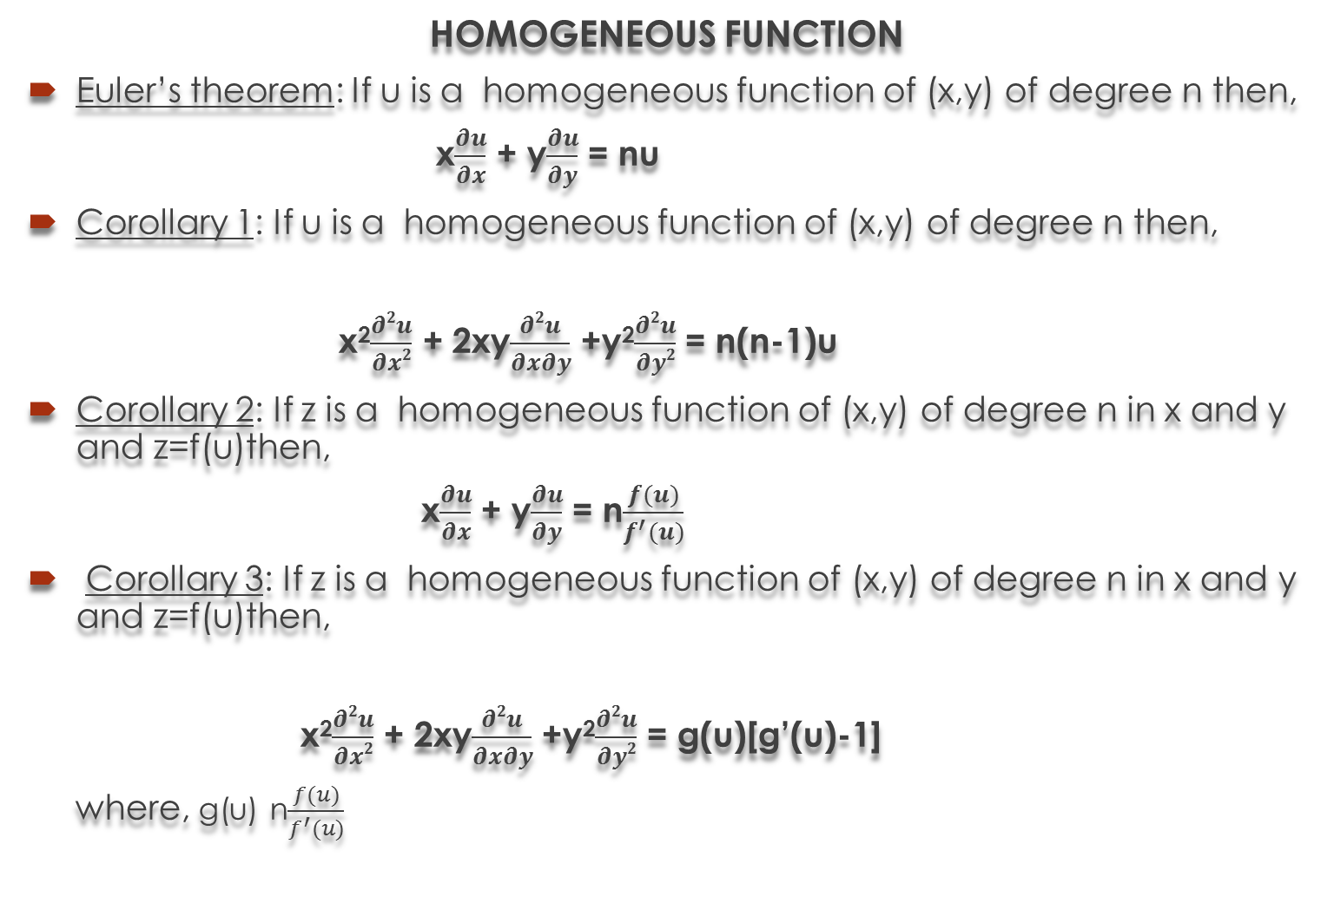
HOMOGENEOUS FUNCTION
Euler’stheorem: If u is a homogeneous function of (x,y) of degree n then,
x$\frac{∂u}{∂x}$ + y$\frac{∂u}{∂y}$ = nu
Corollary 1: If u is a homogeneous function of (x,y) of degree n then,
x²$\frac{∂2u}{∂x2}$ + 2xy$\frac{∂2u}{∂x∂y}$ +y²$\frac{∂2u}{∂y2}$ = n(n-1)u
Corollary 2: If z is a homogeneous function of (x,y) of degree n in x and y and z=f(u)then,
x$\frac{∂u}{∂x}$ + y$\frac{∂u}{∂y}$ = n$\frac{f(u)}{f^{′}(u)}$
Corollary 3: If z is a homogeneous function of (x,y) of degree n in x and y and z=f(u)then,
x²$\frac{∂2u}{∂x2}$ + 2xy$\frac{∂2u}{∂x∂y}$ +y²$\frac{∂2u}{∂y2}$ = g(u)[g’(u)-1]
where,g(u) n$\frac{f(u)}{f^{′}(u)}$

Slide 5
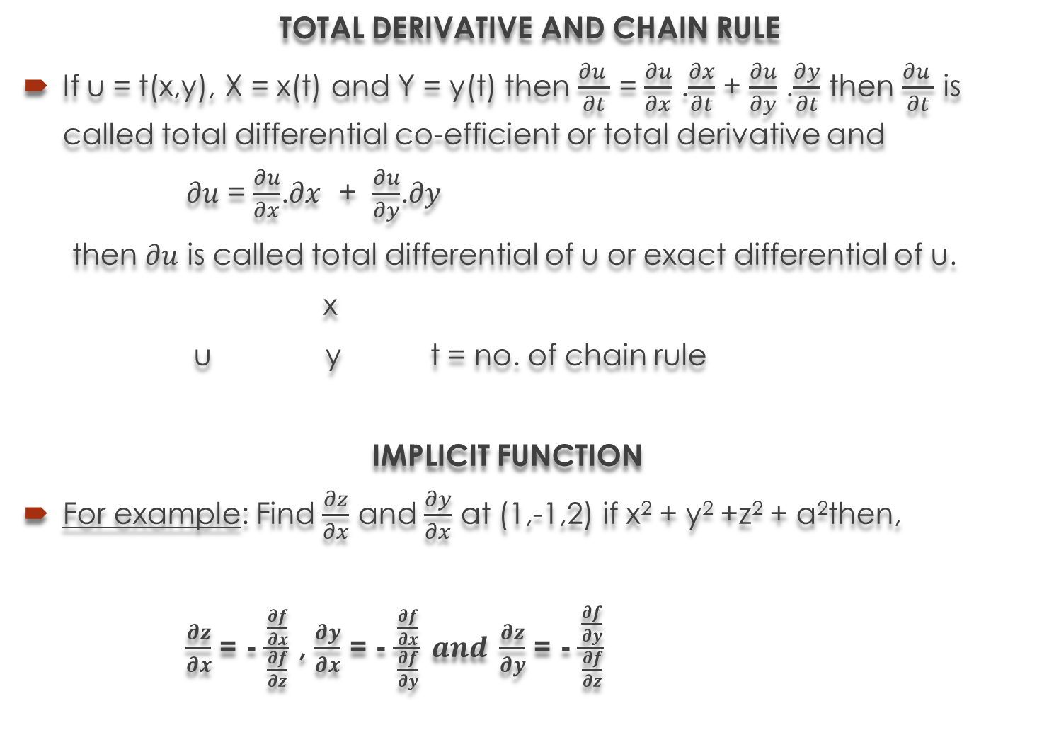
TOTAL DERIVATIVE AND CHAIN RULE
If u = t(x,y), X = x(t) and Y = y(t) then $\frac{∂u }{∂t}$ = $\frac{∂u}{∂x}$ .$\frac{∂x}{∂t}$ + $\frac{∂u}{∂y}$ .$\frac{∂y}{∂t}$ then $\frac{∂u }{∂t}$ is called total differential co-efficient or total derivative and
$∂u$ = $\frac{∂u}{∂x}$.$∂x$ + $\frac{∂u}{∂y}$.$∂y$
then $∂u$ is called total differential of u or exact differential of u.
x
u y t = no. of chain rule
IMPLICIT FUNCTION
For example: Find $\frac{∂z}{∂x}$ and $\frac{∂y}{∂x}$ at (1,-1,2) if x² + y² +z² + a²then,
$\frac{∂z}{∂x}$ = - $\frac{\frac{∂f}{∂x}}{\frac{∂f}{∂z}}$ ,$\frac{∂y}{∂x}$ = - $\frac{\frac{∂f}{∂x}}{\frac{∂f}{∂y}} and \frac{∂z}{∂y}$ = - $\frac{\frac{∂f}{∂y}}{\frac{∂f}{∂z}}$

Slide 6
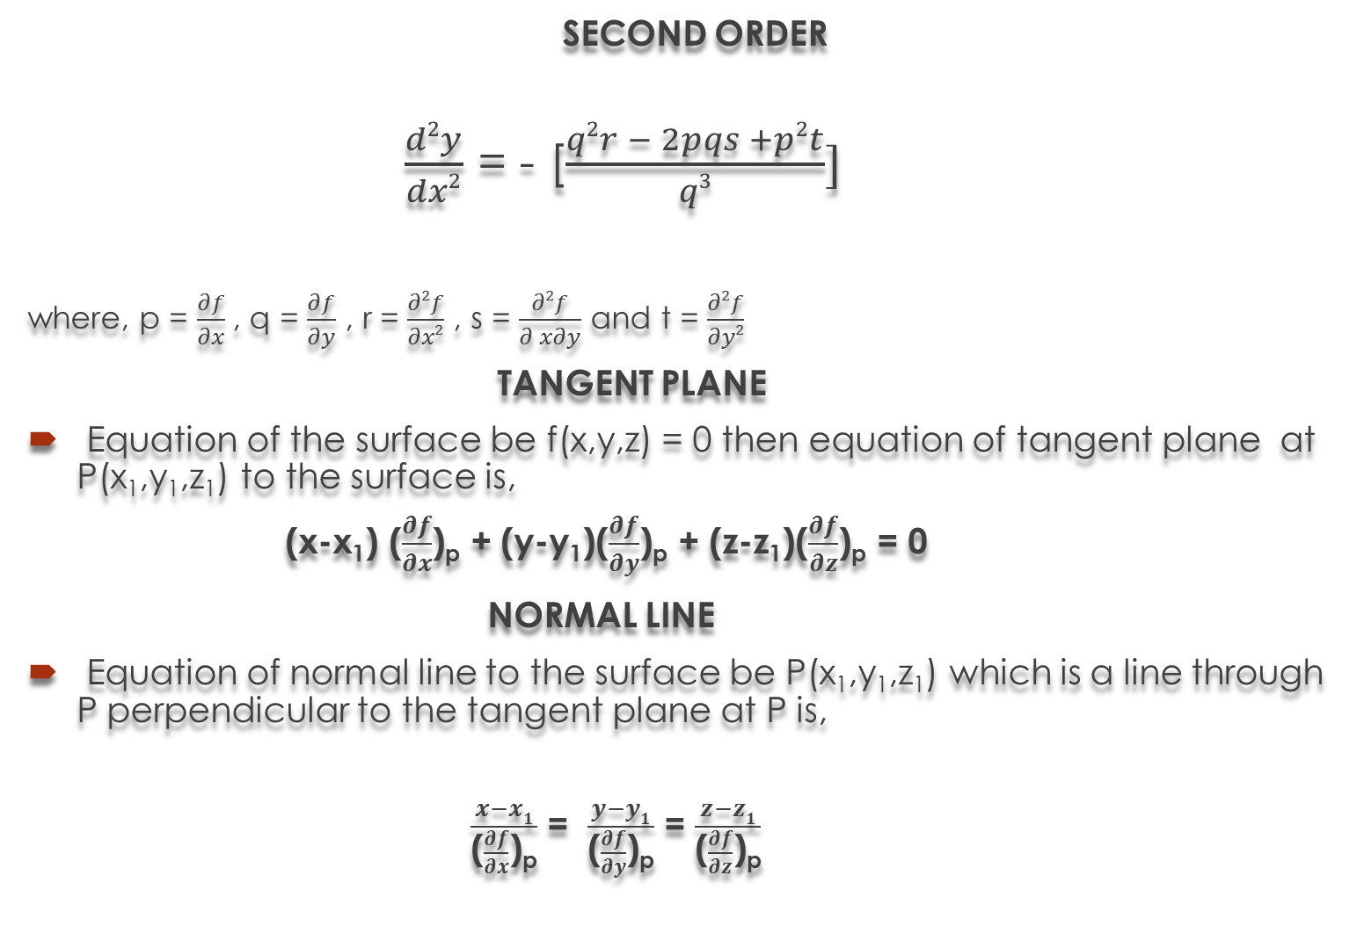
SECOND ORDER
$\frac{d2y}{dx2}$ = - [$\frac{q2r − 2pqs +p2t}{q3}]$
where, p = $\frac{∂f}{∂x}$, q = $\frac{∂f}{∂y}$ , r = $\frac{∂2f}{∂x2}$ , s = $\frac{∂2f}{∂ x∂y}$ and t = $\frac{∂2f}{∂y2}$
TANGENT PLANE
Equation of the surface be f(x,y,z) = 0 then equation of tangent plane at P(x₁,y₁,z₁) to the surface is,
(x-x₁)($\frac{∂f}{∂x}$)_{p} + (y-y₁)($\frac{∂f}{∂y}$)_{p} + (z-z₁)($\frac{∂f}{∂z}$)_{p}= 0
NORMAL LINE
Equation of normal line to the surface be P(x₁,y₁,z₁) which is a line through P perpendicular to the tangent plane at P is,
$\frac{x−x1}{\text{(}\frac{∂f}{∂x}\text{)}\text{p}}$ =$\frac{y−y1}{\text{(}\frac{∂f}{∂y}\text{)}\text{p}}$ = $\frac{z−z1}{\text{(}\frac{∂f}{∂z}\text{)}\text{p}}$

Slide 7
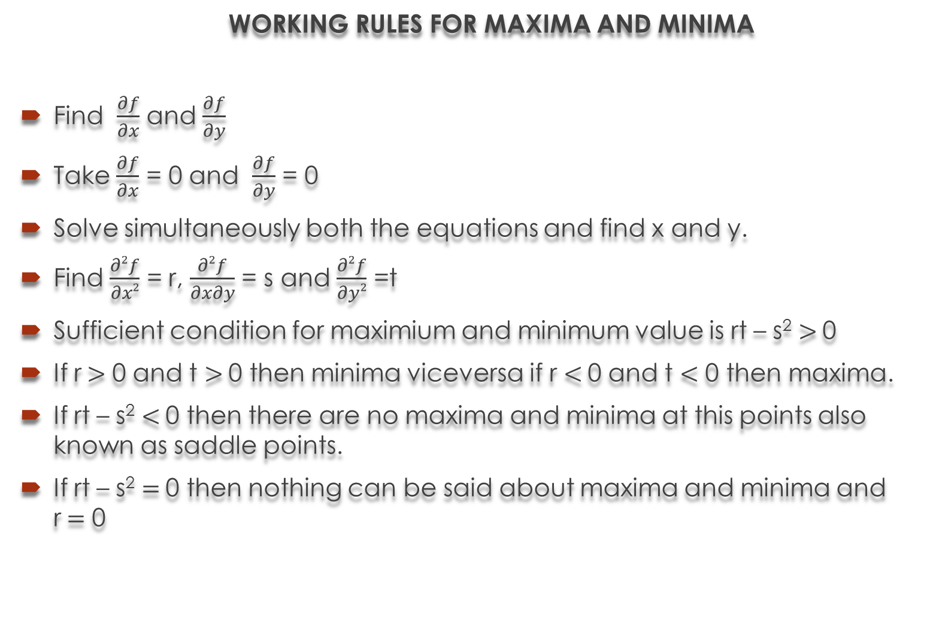
WORKING RULES FOR MAXIMA AND MINIMA
Find $\frac{∂f}{∂x}$ and $\frac{∂f}{∂y}$
Take $\frac{∂f}{∂x}$ = 0 and $\frac{∂f}{∂y}$ = 0
Solve simultaneously both the equations and find x and y.
Find $\frac{∂2f}{∂x2}$ = r, $\frac{∂2f}{∂x∂y}$ = s and $\frac{∂2f}{∂y2}$ =t
Sufficient condition for maximium and minimum value is rt – s²$>$0
If r$>$ 0 and t $>$0 then minima viceversa if r $<$0 and t $<$ 0 then maxima.
If rt – s²$<$0 then there are no maxima and minima at this points also known as saddle points.
If rt – s²$=$0 then nothing can be said about maxima and minima and r$=$ 0

Slide 8
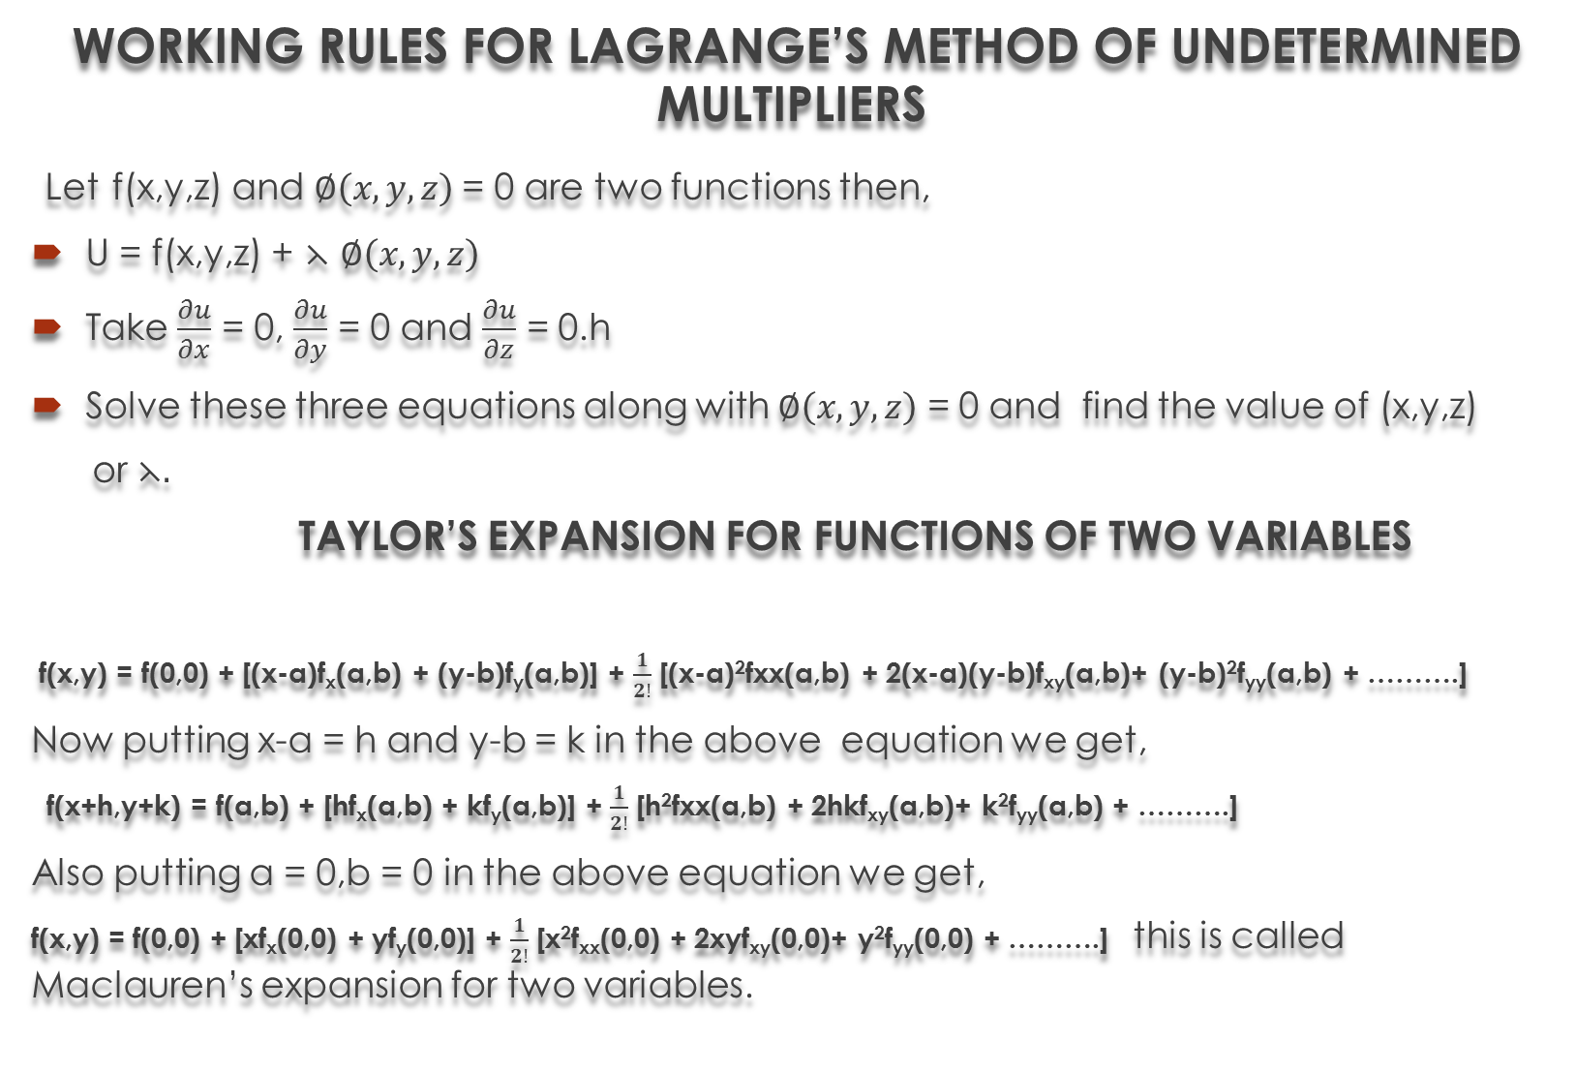
WORKING RULES FOR LAGRANGE’S METHOD OF UNDETERMINED MULTIPLIERS
Letf(x,y,z) and $∅\left(x,y,z\right)$= 0 are two functions then,
U = f(x,y,z) + $⋋$$∅\left(x,y,z\right)$
Take $\frac{∂u}{∂x}$ = 0, $\frac{∂u}{∂y}$ = 0 and $\frac{∂u}{∂z}$ = 0.h
Solve these three equations along with $∅\left(x,y,z\right)$ = 0 and find the value of (x,y,z)
or$⋋.$
TAYLOR’S EXPANSION FOR FUNCTIONS OF TWO VARIABLES
f(x,y) = f(0,0) + [(x-a)f_{x}(a,b) + (y-b)f_{y}(a,b)] + $\frac{1}{2!}$ [(x-a)²fxx(a,b) + 2(x-a)(y-b)f_{xy}(a,b)+ (y-b)²f_{yy}(a,b) + ……….]
Now putting x-a = h and y-b = k in the above equation we get,
f(x+h,y+k) = f(a,b) + [hf_{x}(a,b) + kf_{y}(a,b)] + $\frac{1}{2!}$[h²fxx(a,b) + 2hkf_{xy}(a,b)+ k²f_{yy}(a,b) + ……….]
Also putting a = 0,b = 0 in the above equation we get,
f(x,y) = f(0,0) + [xf_{x}(0,0) + yf_{y}(0,0)] + $\frac{1}{2!}$[x²f_{xx}(0,0) + 2xyf_{xy}(0,0)+ y²f_{yy}(0,0) + ……….] this is called Maclauren’s expansion for two variables.

Slide 9


